Slide 1
THE IVORY WHISK - Where every BITE is a MASTERPIECE

Slide 2
agenda
INTRODUCTION
Campaign objectives
Bid & Budget allocation.
Ad format preferences
Target audience details

Slide 3
INTRODUCTION
.
This project focuses on designing and implementing a Facebook marketing campaign for The Ivory Whisk, a premium bakery brand. The objective of the campaign is to increase brand awareness, engage potential customers, and promote the bakery's products through targeted digital marketing strategies. The project involves audience research, campaign planning, ad creation, budget allocation, and performance analysis using Facebook Ads Manager.
The Ivory Whisk is a premium bakery that specializes in high-quality cakes, pastries, cookies, and other baked goods. The brand is committed to delivering fresh, delicious, and beautifully crafted products that provide customers with a memorable experience. With a focus on quality, creativity, and customer satisfaction, The Ivory Whisk aims to establish itself as a preferred destination for bakery and dessert lovers. Through digital marketing initiatives, the company seeks to expand its reach, attract new customers, and strengthen its online presence. :::This introduction is professional and dessert lovers. Through digital marketing initiatives, the company seeks to expand its reach, attract new customers, and strengthen its online presence.

Slide 4
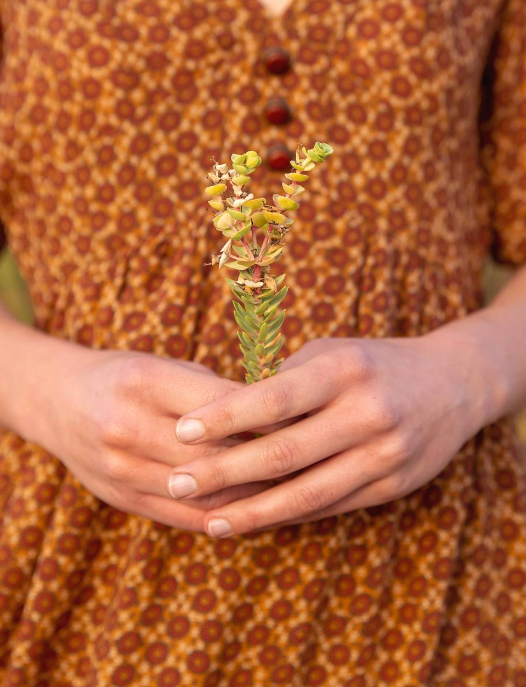
Campaign objectives

Slide 5
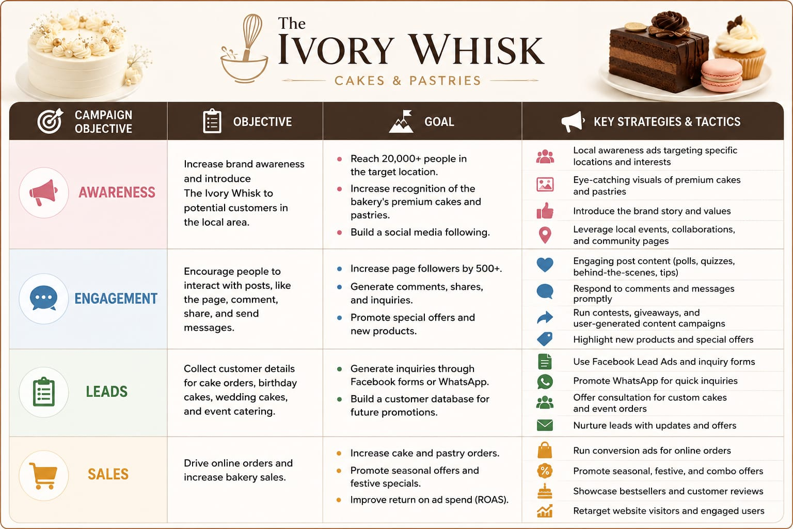

Slide 6
BID AND ALLOCATIONS

Slide 7
The Facebook advertising campaign for The Ivory Whisk will use the Lowest Cost Bidding Strategy, allowing Facebook to automatically optimize ad delivery and achieve the maximum results within the allocated budget . Campaign Budget Total Campaign Budget: ₹7,500 Campaign Duration: 15 Days Daily Budget: ₹500Budget Allocation Awareness Campaign: 40% (₹3,000)Focus on reaching new audiences and increasing brand visibility . Engagement Campaign: 35% (₹2,625)Encourage likes, comments, shares, and page follows . Lead Generation Campaign: 25% (₹1,875)Generate inquiries for custom cakes, events, and special orders . Expected Outcomes Reach: 20,000–30,000 people Engagement: 1,000+ interactions Leads: 50+ customer inquiries This budget allocation ensures balanced spending across awareness, engagement, and lead generation objectives while maximizing overall campaign performance.

Slide 8
AD FORMAT PREFRENCE

Slide 9
The Ivory Whisk will use a combination of Facebook ad formats to effectively showcase its bakery products and engage potential customers.
1. Image Ads ; Display high-quality images of cakes, pastries, cookies, and bakery specials . Suitable for building brand awareness and attracting attention.
2. Carousel Ads ; Showcase multiple bakery products in a single advertisement . Allow customers to view different cake designs, flavors, and special offers
.3. Video Ads; Feature short videos of cake decoration, baking processes, and customer testimonials . Increase engagement and create a stronger connection with the audience.
4. Story Ads; Full-screen vertical ads displayed on Facebook and Instagram Stories . Ideal for promoting limited-time offers, festive specials, and new product launches .
Preferred Format The primary ad formats for this campaign will be Carousel Ads and Video Ads, as they provide visually appealing content, highlight multiple products, and generate higher engagement among the target audience

Slide 10
Target Audience detail

Slide 11
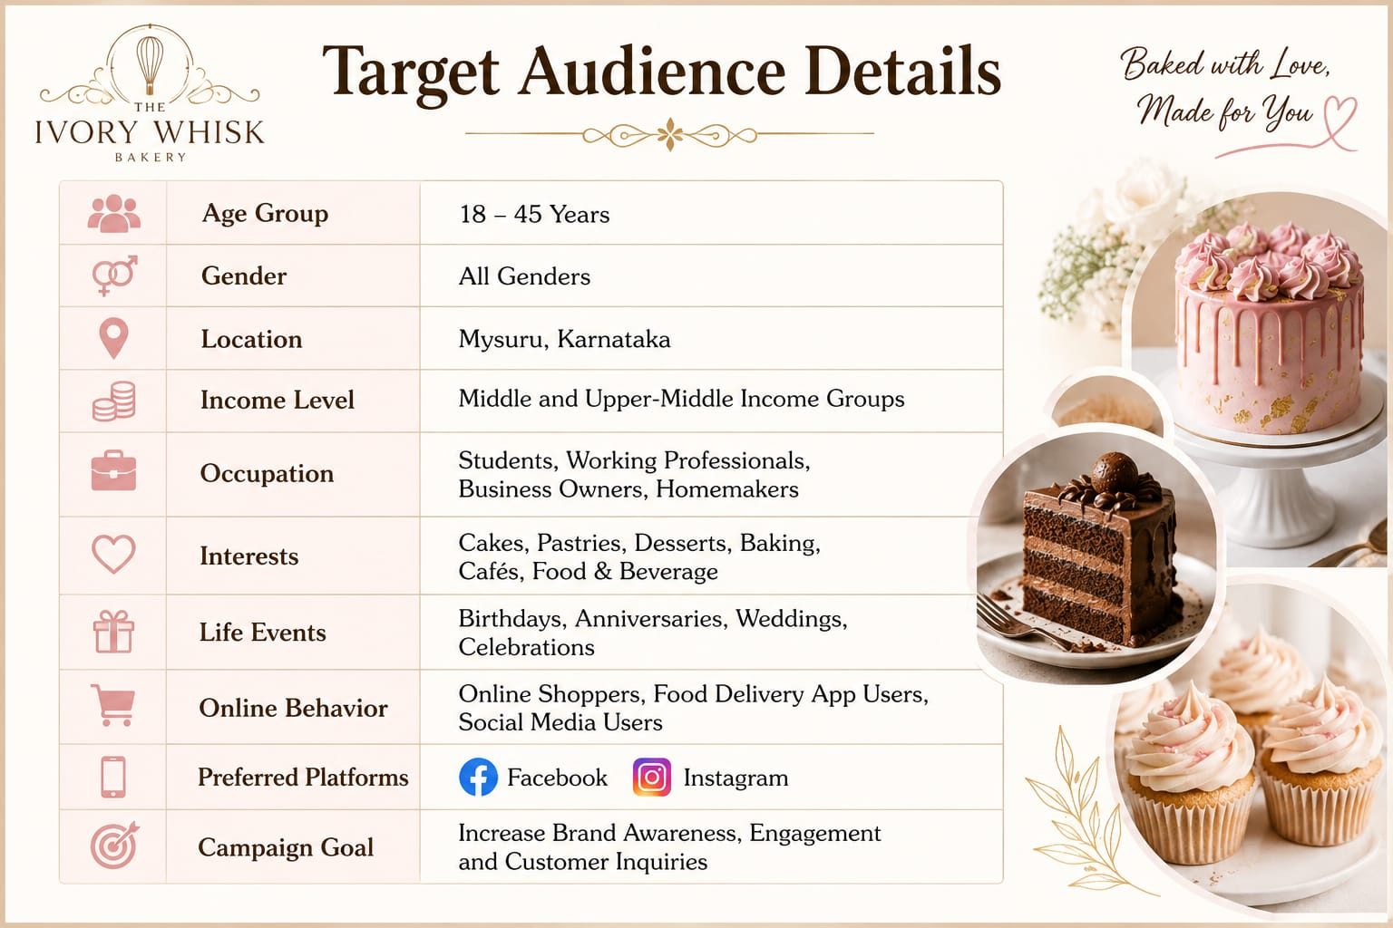

Slide 12
SUMMARY
This project presents a comprehensive Facebook advertising campaign for The Ivory Whisk, a premium bakery brand specializing in cakes, pastries, and baked delicacies. The campaign is designed to increase brand awareness, engage potential customers, and generate inquiries and orders through strategic digital marketing . The campaign targets individuals aged 18–45 in Mysuru who are interested in bakery products, desserts, celebrations, and online shopping. Using Facebook and Instagram advertising, the campaign employs a mix of image, carousel, video, and story ads to showcase the bakery's products and attract customers . A budget of ₹7,500 has been allocated across awareness, engagement, and lead-generation objectives, with Facebook's lowest-cost bidding strategy used to maximize campaign performance. The expected outcomes include increased brand visibility, higher social media engagement, growth in followers, and more customer inquiries for custom cakes and bakery products . Overall, the project demonstrates how social media advertising can help The Ivory Whisk strengthen its online presence, connect with its target audience, and drive business growth in a competitive market.

Slide 13
THANK YOU

